Slide 1

Web Application for Predicting Housing prices
160119737042
160119737043

Slide 2
CONTENTS
Introduction
Software and Hardware requirements
Architecture of Application
Process
Input
Output
Scope for improvement
Summary
Resources

Slide 3

Introduction
Real estate is the least transparent industry in our ecosystem. Housing prices keep changing day in and day out and sometimes are hyped rather than being based on valuation. Predicting housing prices with real factors is the main crux of our research project.

Slide 4
Software and Hardware Requirements
Hardware requirements
Software requirements
Modern system RAM is sufficient
Disk space of 200 MB (approx.)
Python version 3.6
Flask
ML based libraries
Any text editor (e.g., atom)
Web browser (e.g., chrome, safari etc.)
Jupyter notebook (Anaconda optional)

Slide 5
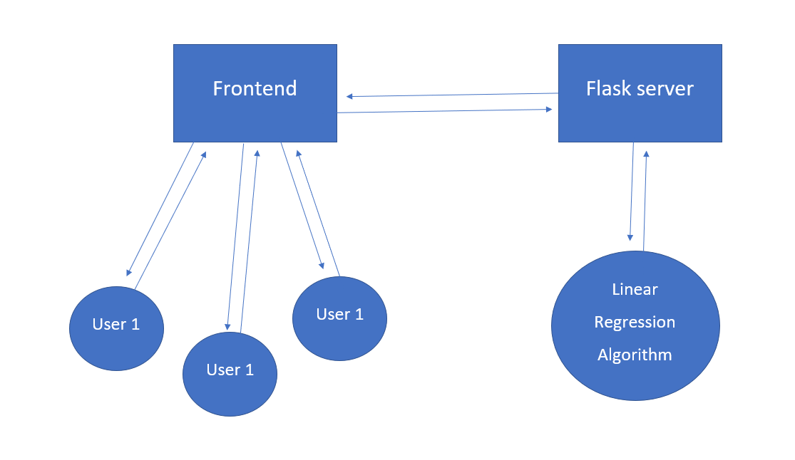
Architecture of Application

Slide 6
Process
When we click on the link http://127.0.0.1:5000/ we were sending GET request to the server(flask application),then it returns a landing page. After providing the requirements through form input, we can click submit on landing page. Then the form input is given to server which then computes estimated price using ml model that we have trained, after the prices is calculated it is then displayed in a new html page.

Slide 7
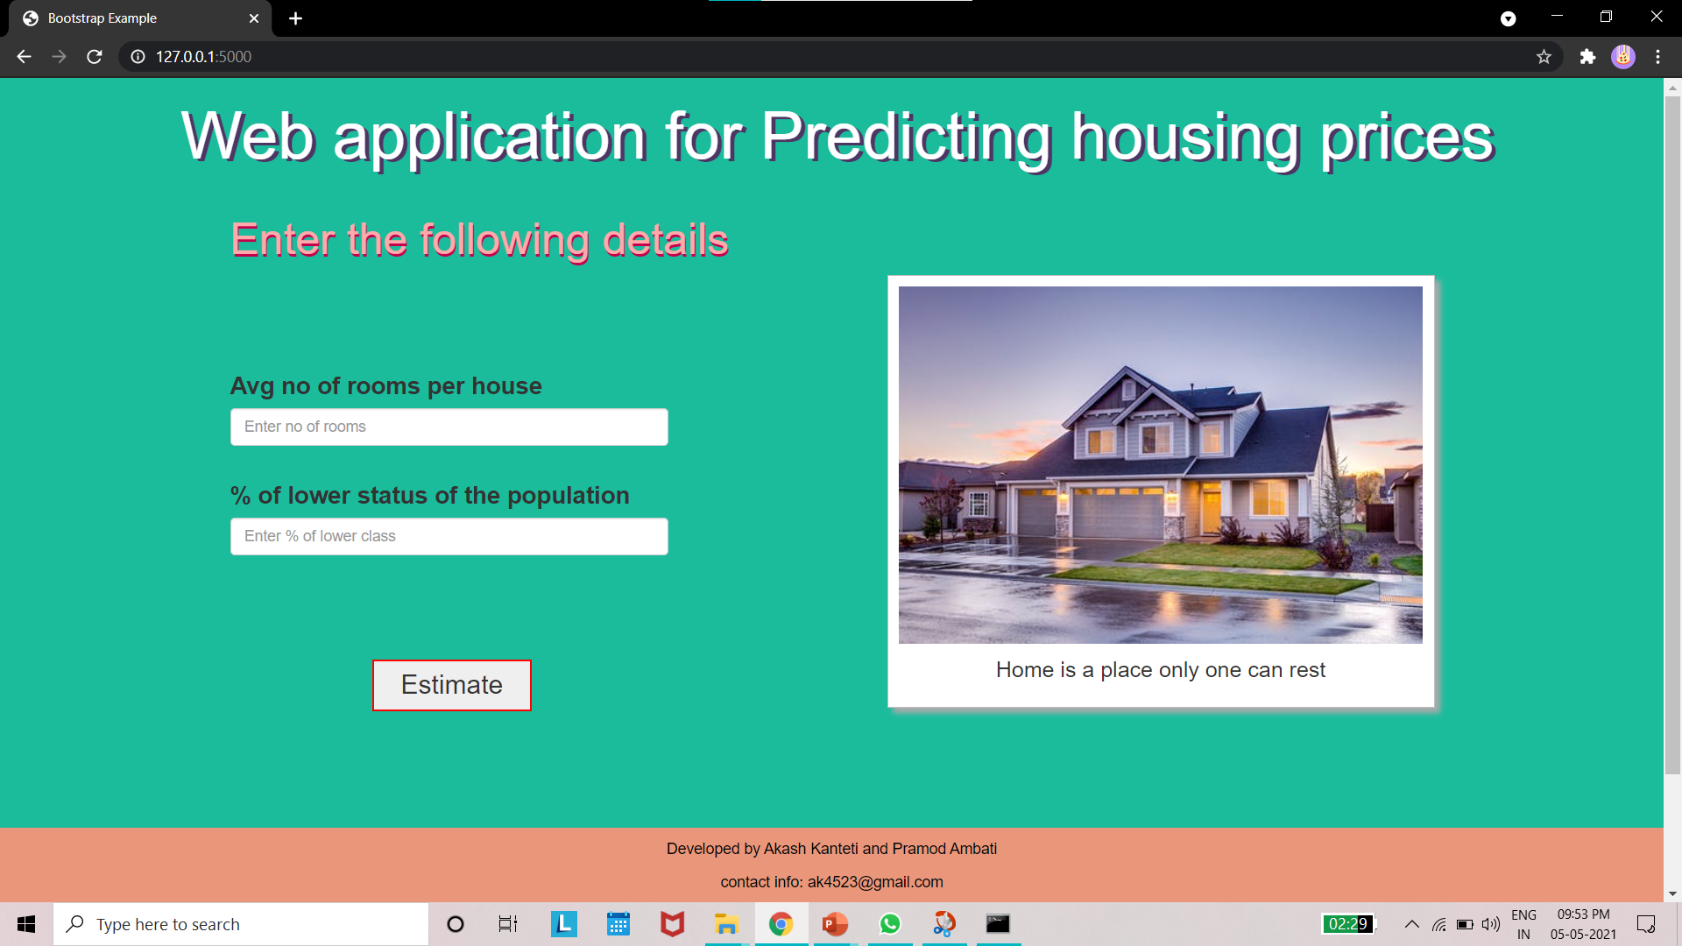
INPUT

Slide 8
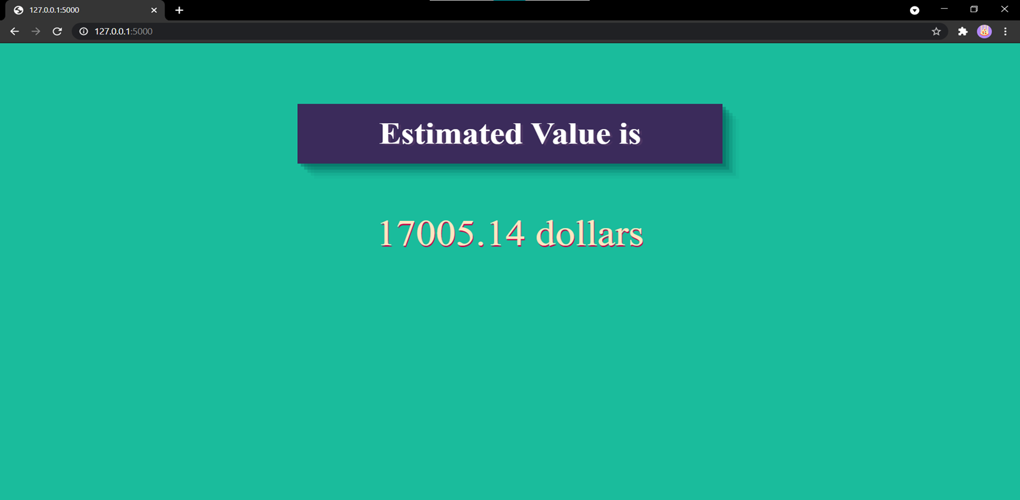
OUTPUT

Slide 9
Scope for Improvement
At present the application can predict house prices for Boston city. An enhancement can be made to make it available for other places like Bangalore, California etc. Depending on availability and content of datasets.

Slide 10

SUMMARY
The phenomenon of the falling or rising of the house prices has attracted interest from the researcher as well as many other interested parties. So, we developed this application in a minimal way such that everyone interested in real estates can use this application.

Slide 11
RESOURCES
W3School
https://towardsdatascience.com/a-data-science-web-app-to-predict-real-estate-price-d2366df2a4fd
https://ieeexplore.ieee.org/abstract/document/8473231
Stack overflow
FreeCodeCamp

Slide 12

THANK YOU

